Slide 1
Millions & Billions
OpenAI, Tesla, and IBM

Slide 2
News

Slide 3
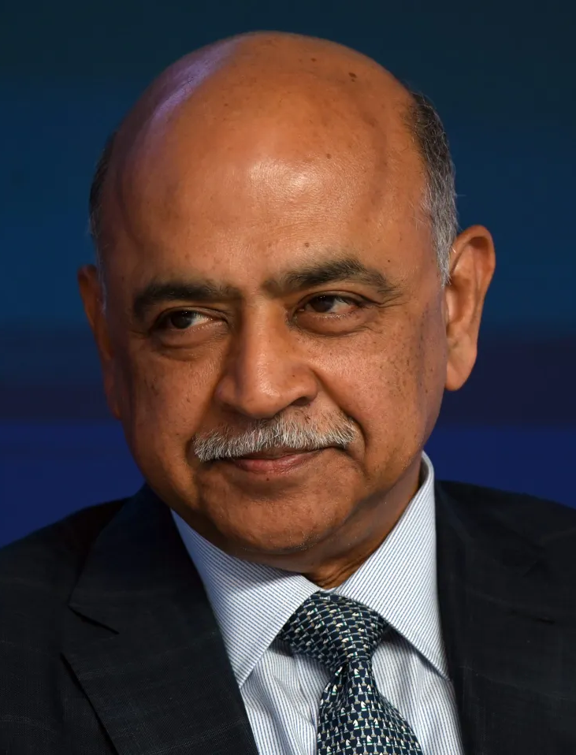
IBM invests in Huggingface
Arvind Krishna, CEO of IBM
Froze thousands of jobs earlier this year
3,900 layoffs planned
7,800 positions frozen
Says AI could take over 30% to 50% of repetitive tasks (and do them better than humans)
$235M Series D Funding Round
Hugging Face now worth $4.5B
They have collaborated on WatsonX
Doubling down on AI

Slide 4
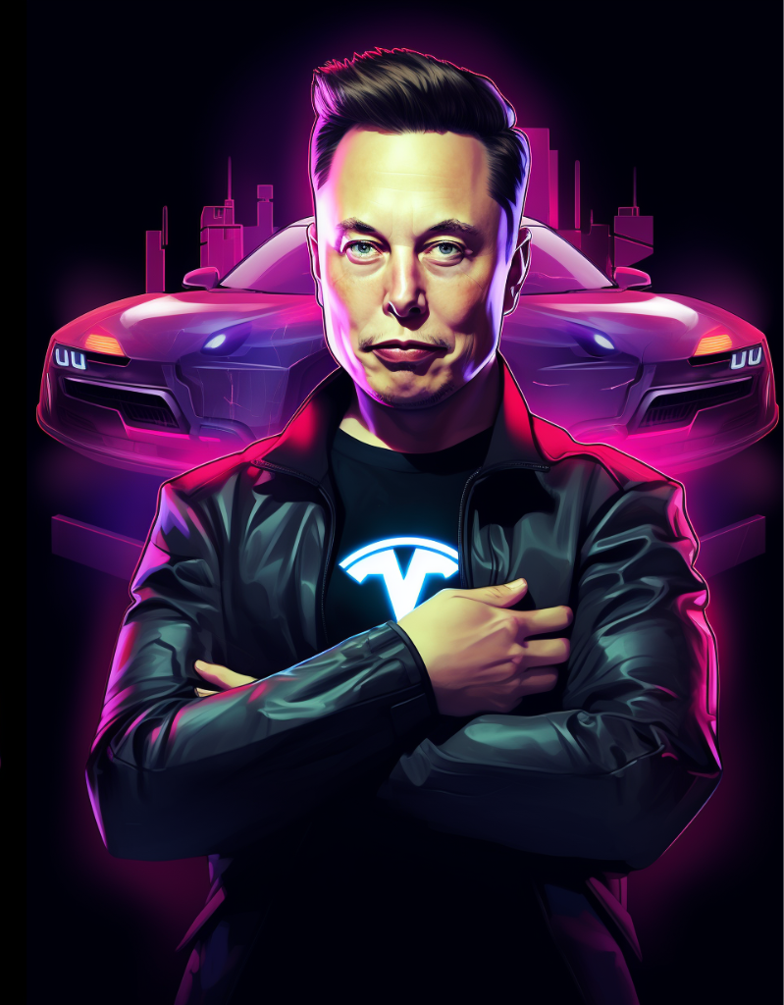
Tesla Giga Computer
Turned on HPC cluster worth $300M
Powered by 10,000 Nvidia H100 compute GPUs
Primarily for FSD and other HPC workloads
Elon has said they will invest $4B in more AI
Plan is to invest over the next 2 years
Investing another $1B into Dojo supercomputer
Doubling down on AI

Slide 5

OpenAI Revenue Explodes
On track to generate more than $1B in revenue
Up from $28M in revenue last year
>35x in revenue growth
ChatGPT costs $700k per day (estimated)
Not sure if they are cash positive
Microsoft entitled to 75% of revenue
Could take a decade to pay it off
That timeframe may shorten quite a lot
Looks like their investment paid off!

Slide 6
Analysis

Slide 7
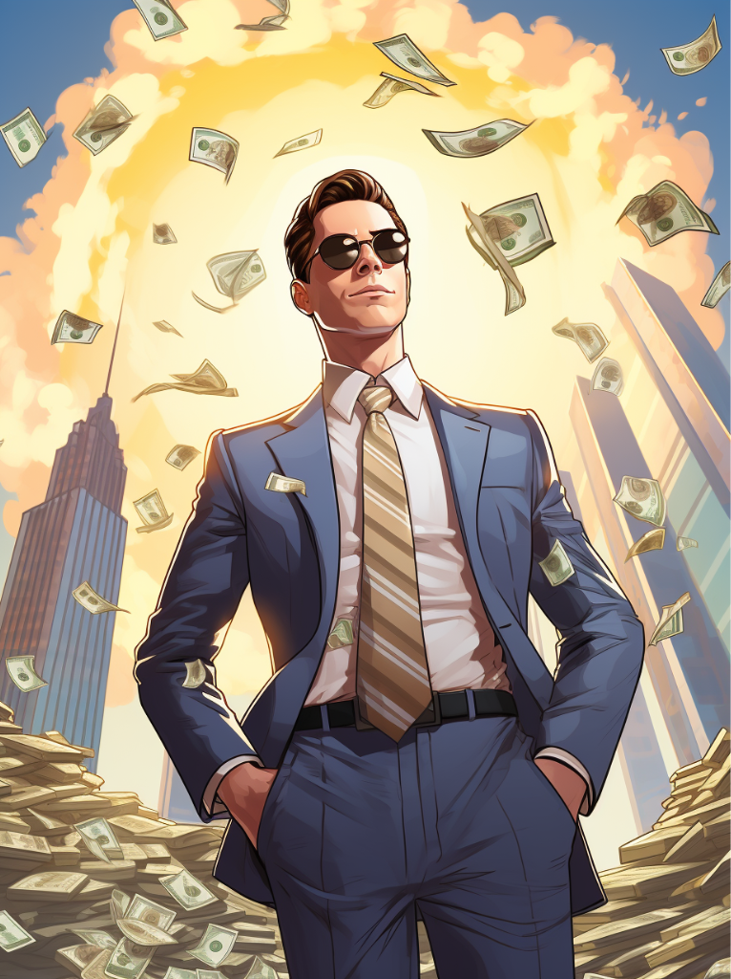
AI Investment Growth
Global AI Investment
2020: $30B
2021: $66.8B
2022: $92B
2023: ???
2025: $200B (Goldman Sachs forecast)
Current opinions mixed
Some signs of investment slowing or accelerating
But we’re only in September
Consensus seems to be things are chugging along more or less as expected

Slide 8
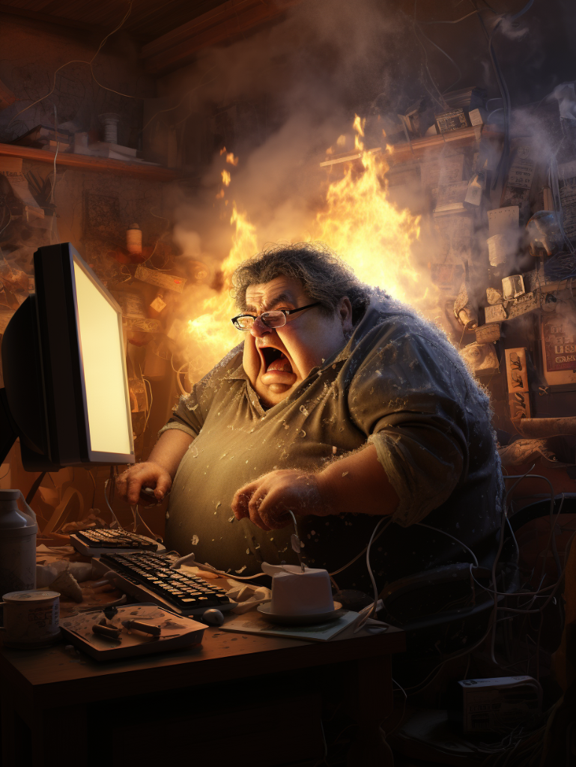
Tech Layoffs, New Jobs
150,000+ US tech layoffs as of June
Total unemployment remains at 3.5%
Government source (MLS)
About 375k open jobs as of January
Forecasts said 272k new tech jobs in 2023
Remains to be seen… (not a government source)
AI expected to destroy 85M jobs by 2025
But create up to 97M jobs
Net gain of 12M
Not a government source, so take it with a grain of salt
That’s a LOT of reskilling!
Generative AI job postings up 20% in May
Maybe it’s a wash? So far so good.
Just make sure you’re up to date on Generative AI tools

Slide 9
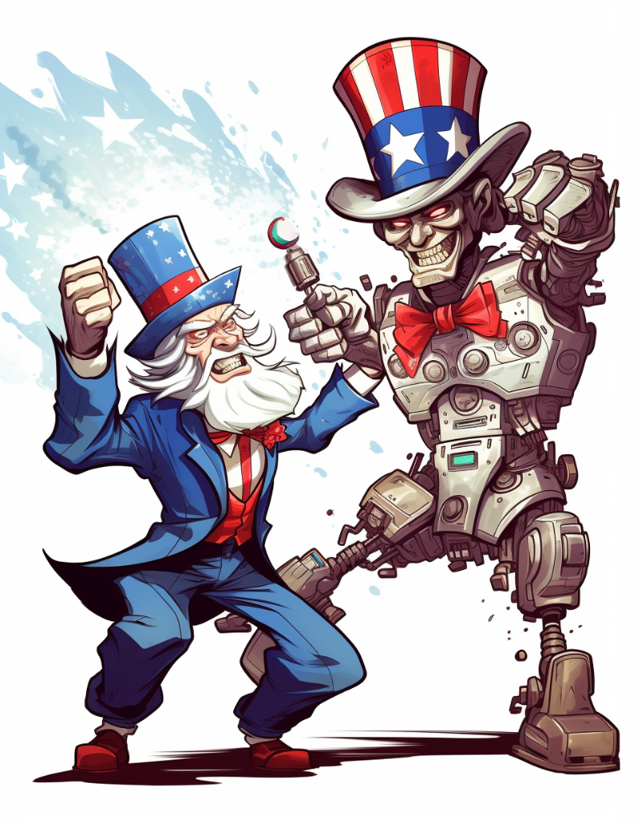
Public Sentiment
Reuters/Ipsos poll: 61% of Americans view AI as potential threat to human civilization
Pew Research poll: 58% of Americans more concerned than excited about the rise of AI
Economist/YouGov poll: ~75% of Americans believe AI should be regulated by government
79% Democrat
73% Republican

Slide 10
Conclusion

Slide 11

Predictions
AI investment may cool slightly
OpenAI lawsuits seem to have spooked the markets
Still, turning red hot fast
This will be brief if at all
Americans are largely united on regulations, fears
Regulatory capture still a primary concern
Rarely see this much consensus!
State of jobs right now seems good
Post-Labor Economics will have to wait (and UBI)
Keep your eyes open, though, we’re in for an interesting future
Many industries are being disrupted (tech, marketing, translation, copywriting, etc)

Slide 12

Takeaways
Skill up!
Learn to use AI tools
Learn the basics of AI
Job market transformation is actively happening
I’m happy to do remote training, groups, ping me
Might do paywalled training, not sure
Reminds me of early 2000’s with the rise of Microsoft and developer and IT certifications
Voter solidarity
Americans are rarely this united on something
Don’t count the chickens yet
CONSTANT VIGILANCE!

Slide 13
Thank you

